Slide 1
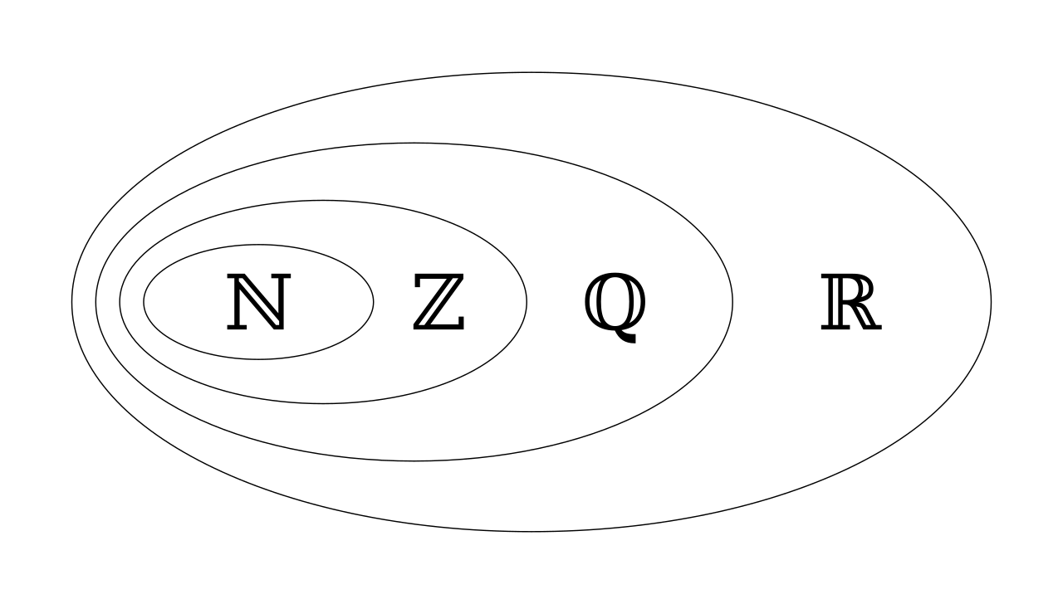
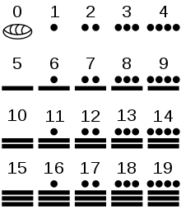
Numbering Systems Review
Natural numbers: Things that we count and the base system
base 60: from the Sumerians: used for time, angles, geographical coordinates
base 20: e.g., the Mayan system
base 12: Jan, Feb, … Dec
base 10: Jan, Feb, … June, Sept, Oct, Nov, Dec!
base 7: Sun, Mon,Tues, … Sat, Sun
base 2, 8 (2^3), 16 (2^4)
unary: 110, 11110, 11111111111110, 111011011110=324
Integers: Positive, Zero, and Negative
Rational: e.g., ⅓, 2.3 but not… 𝝅
Real Numbers: e.g., 𝝅
Complex Numbers: e.g., 3 + 2ί where ί = √-1
The concept of both -∞ and ∞, x/0 == NaN

Slide 2
Different Representations for "42.25"
Decimal:
42.25
10#42.25 (Bash shell)
4.225 x10^ 2
4.225E02 (calculators)
Hexadecimal:
0x2A.4
16#2A.4
2.A4 x16^ 1
Octal:
052.2 (Java, C, etc, but not Javascript)
0o52.2 (Javascript)
8#52.2
5.22 x8^ 1
Binary:
0b101010.01
2#101010.01
1.0101001 x2^ 101
In COMP122:
Use context
Allow spacing for clarity
Allow for separators
Allow for signs
Examples:
- 101001.0100 x 2^ -101
1010 1010 1101 1111
10 1111, 10100, 00101, 10101, 10100, 10 1010

Slide 3
Computer Limitations and Representation
Recall the Universal Computer
There is a limited tape size to perform calculation
Recall the von Neumann and Harvard architecture
There is a predefined width to registers and memory
Abstract representations with limited sizes for:
Natural Numbers & Zero: unsigned char, unsigned int
Integers: short int, int, long int, long long int
Rational/Real:
Fix Point ---
Floating Point float (singal), double
An encoding of each will include one or more of the following:
+ 4.225 x10^ +2 +1.010101 x2^ +101
sign
whole
fractional
expon sign
exponent

Slide 4
Expanded Notation
Recall from grade school
1234 = | 1 x 10^3 | 1 * 1000 = 1000
 | + 2 x 10^2 | 2 * 100 = 200
 | + 3 x 10^1 | 3 * 10 = 30
 | + 4 x 10^0 | 4 * 1 = 4
 |  | 1234
thousands | hundreds | tens | ones
1 | 2 | 3 | 4

Slide 5
Expanded Notation for other Bases
Radix Point
BASE | Columns
Base 16 | 4096's | 256's | 16's | 1's | 1/16 | 1/256
Base 10 | 1000's | 100's | 10's | 1's | 1/10 | 1/100
Base 8 | 512's | 64's | 8's | 1's | 1/8 | 1/64
Base 2 | 8's | 4's | 2's | 1's | 1/2 | 1/4

Slide 6
Expanded Notation
Recall from grade school
154 = | 1 x 10^2 | 100
 | + 5 x 10^1 | 50
 | + 4 x 10^0 | 4
 |  | 154

Slide 7
Expanded Notation
10 | A
11 | B
12 | C
13 | D
14 | E
15 | F
Base 10 Value
Base 16 16# 9A
Base 8 0o232 8# 232
0x9A = | 9 x 16^1 | 9 x 16 = 144
 | + A x 16^0 | 10 x 1 = 10
 |  | 154
Base 10 Value
0232 = | 2 x 8^2 | 2 * 64 = 128
 | + 3 x 8^1 | 3 * 8 = 24
 | + 2 x 8^0 | 2 * 1 = 2
 |  | 154

Slide 8
Expanded Notation
1001 1010 = | 1 x 2^7 | 128
 | + 0 x 2^6 | 0
 | + 0 x 2^5 | 0
 | + 1 x 2^4 | 16
 | + 1 x 2^3 | 8
 | + 0 x 2^2 | 0
 | + 1 x 2^1 | 2
 | + 0 x 2^0 | 0
 |  | 154
Base 2: 2# 1001 1010

Slide 9
Real Numbers
45.34
- 45.34
1011110.0100
- 1011110.0100
But what about my limitations on the computer!
radix point
1000
1000000.1011110
01

Slide 10
Fixed Point Numbers
There is a need to represent rational numbers
Consider operations on US currency. (dollars and cents)
Place the two digits after the decimal (radix) point
Provide a register of size 6
Note:
We can't represent standard price of a gallon of gas! $4.96 9/10
+

Slide 11
Scientific Notation
14.3 x 10⁷
9.2 x 10⁷
5.1 x 10⁷
All numbers represented as: m x 10^{N}
Simplifies operations on large and small numbers.
Distance between sun and earth: 92,000,000 = 9.2 x 10⁷
Distance between sun and mars: 143,000,000 = 1.43 x 10⁸
Floating point representation
a representation of scientific notation
introduces the notion of infinity, and NaN (0 / 0 = ?, 0 x infinity = ?)
Representation of: -1.1011101 x 2 ⁻¹⁰⁰¹
Assume a size of 16
Note the whole part is alway "1", so I left it out!
-
-
1
0
0
1
1
0
1
1
1
0
1
0
0
0
sign
exponent part with sign
fractional part

Slide 12
Floating Point Encoding
foreshadow
Symbol | Encoding
+ | 0
- | 1
always 1: so we don't store it
Original number: - 0.000100101
Recall Scientific Notation: - 1.0100101 x 2 ⁻ ¹⁰⁰ ⁽⁴⁾
Components to Encode
sign: negative
significant or the mantissa: 0100101
exponent: - 100
Issue: negative exponents
Solution: store values with a bias
Bias:
Shift all numbers along the number line by N
Typically it is half the range:
3 bits -> 011 == 3
5 bits -> 0 1111 == 15
8 bits -> 0111 1111 == 127
11 bits -> 011 1111 1111 == 1023
Number |  | Encoding (Bias: 4)
-4 |  | 000
-3 |  | 001
-2 |  | 010
-1 |  | 011
0 | 000 | 100
1 | 001 | 101
2 | 010 | 110
3 | 011 | 111

